Slide 1
Presentation 13.9.17
Andy Mills Manager Complex Needs Team

Slide 2
Tiers of Service
Tier 1
Non-Specific services which might come into contact with Substance users
Examples: A&E, GPs, Court, Hostels, Day Centres, Job Centre etc

Slide 3
Tiers of Service
Tier 2
Low Threshold S.U. Specific services providing:
Drop-In
Needle Exchange
Assessment
One to One Counselling
Onward Referral

Slide 4
Tiers of Service
Tier 3
Structured Provision:
Day Programmes
Other structured counselling services
Prescribing
Community Detox

Slide 5
Tiers of Service
Tier 4
Residential Detox
Residential Rehab
Tier 4a
Liver
HIV

Slide 6
Criminal Justice Services
DiP Teams (Drug Interventions Programme)
For drug using offenders
Pre-arrest
On arrest
On sentencing
In prison
Post-release
A ‘beginning-to-end’ support system
Direct drug using offenders out of crime and into treatment.

Slide 7
Criminal Justice Services
DRR – Drug Rehabilitation Requirement:
Part of a community sentence
A diversion away from custodial sentencing
Must be agreed with the user
A DRR lasts between six months and three years
If ‘breached’ then user will return to court
May then do custodial sentence

Slide 8
Other Community Services
AA – Alcoholics Anonymous
NA – Narcotics Anonymous
CA – Cocaine Anonymous (and others)
SMART recovery
Mutual Aid and peer support groups
Other self-funded charity and faith-based services

Slide 9
St Mungo’s
Outreach Teams
No Second Night Out
Assessment Centres
First Stage Hostels
Semi-Independent Housing
Specialist projects
Registered Care
Mental Health Projects
Women Services
Offender projects

Slide 10
Stats
From 2016 Client Needs Survey
Substance Use Need: 1068 (55%)
Smoker: 1451 (74%)
Alcohol: 587 (30%)
Drugs: 780 (40%)
From Support Overview whole org 3/6/17 to 12/9/17
SU need - 1464 (56%)
Smoker - 1504 (57%)
Alcohol – 794 (30%)
Drugs – 1075 (41%)

Slide 11
Main Substances
From 2016 Client Needs Survey
Alcohol: 587 (30% of total clients)
Clients who misuse substances (%age is of those who reported misuse)
Cannabis: 458 (59%)
Crack: 398 (51%)
Heroin: 338 (43)
Codeine: 7 (1%)
Subutex 20 (3%)
Methadone: 109 (14%)
Cocaine: 109 (14%)
Methamphetamine 9 (1%)
SCRAs 22 (3%)
From Support Overview whole org 3/6/17 to 12/9/17:
Clients who misuse substances (%age is of those who reported misuse)
Cannabis: 569 (53%)
Crack: 536 (50%)
Heroin: 475 (44%)
Codeine: 9 (1%)
Subutex: 32 (3%)
Methadone: 152 (14%)
Cocaine: 148 (14%)
Methamphetamine: 9 (1%)
SCRAs: 39 (4%)

Slide 12
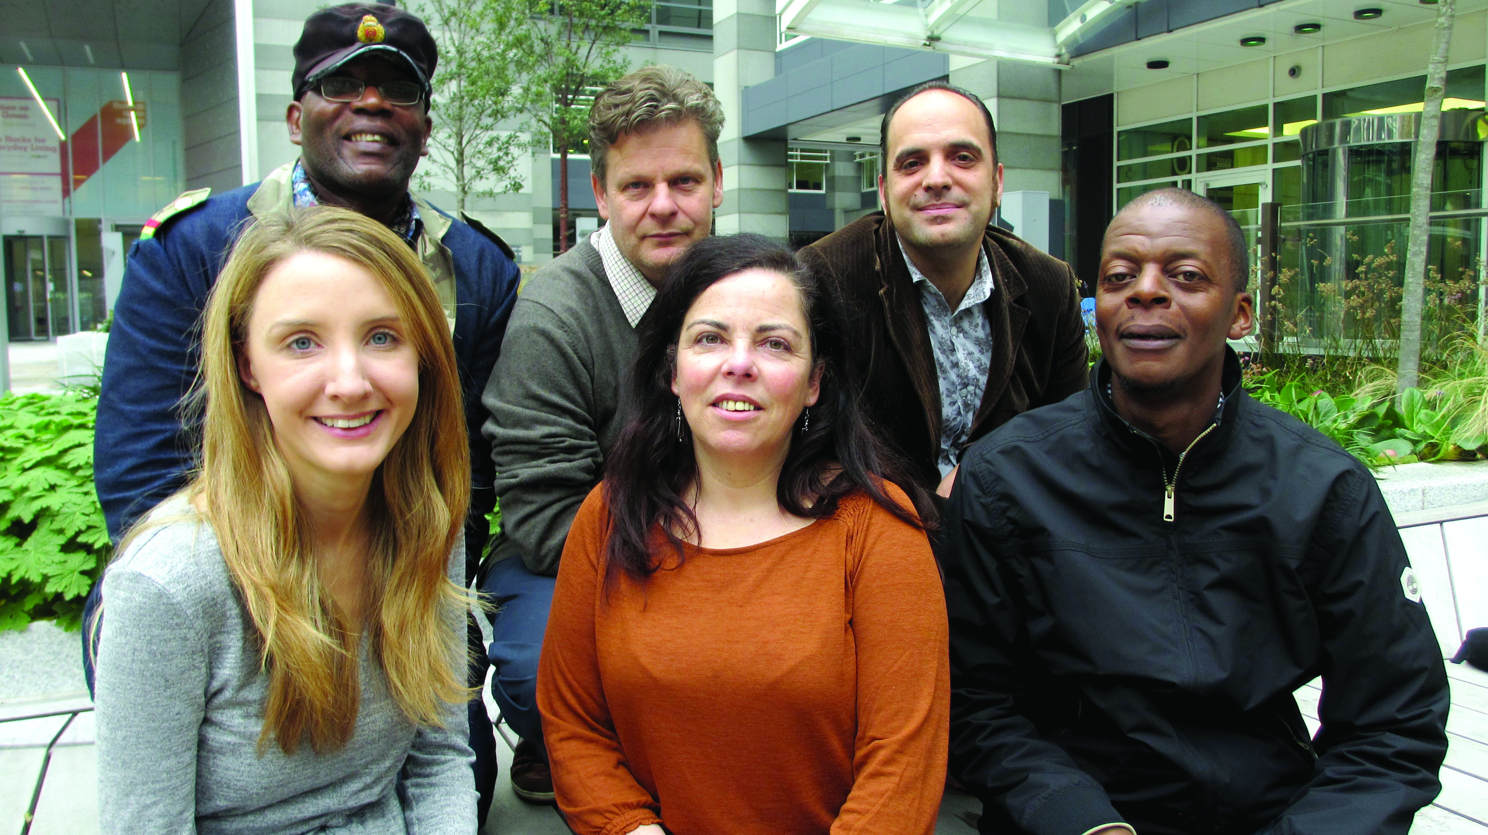
Complex Needs Team
3 x CNW
Palliative care worker
Manager
Deputy
What we do:
Training
Central
Local
Complex Case work
Quality policy and Good Practice
Link with local services

