Slide 1
The Seven P’s of Men’s Violence by Michael Kaufman
Patriarchal Power
The Sense of Entitlement to Privilege
Permission
The paradox of men’s power
The Psychic Armour of Manhood
Masculinity as a Psychic Pressure Cooker
Past Experiences

Slide 2
Patriarchal Power
The triad of men’s violence:
  Men’s violence against women
  Men’s violence against other men
  Violence against the man himself
  This triad of men’s violence occurred in patriarchal or male dominant societies. Here the violence is built into ideologies and structures and it gives benefits for those groups which use it. For example violence and the threat of violence has helped men - as a group - to have privileges and different forms of power.

Slide 3
The Sense of Entitlement to Privilege
It is not only inequalities of power only that lead to violence, but a conscious or often unconscious sense of entitlement to privilege.
Permission
Men’s violence, wouldn’t continue without explicit or unspoken permission in social customs, certain religious teachings, legislation and law enforcement.
Some forms of men’s violence are accepted or even rewarded.

Slide 4
The paradox of men’s power
If power is constructed to be able to dominate and control another people, acting in this kind of way requires distance from others because of the fear caused by the possibility of losing the appearance of being powerful.
The internalized expectations link to masculinity is impossible to attain.
Violence becomes a compensatory mechanism to prove manhood. This expression of violence usually targets those who are physically weaker or more vulnerable.

Slide 5
The Psychic Armour of Manhood
The psychic structures of manhood is shaped in childhood in an environment where the emotional distance or the absence of fathers and other adult men is typically experienced.
Manhood is codified by absence or the rejection of qualities associated with caregiving.
The psychological development may become dampened ability for empathy and an inability to experience other people’s needs and feelings.
That is how violence against another person becomes possible.

Slide 6
Masculinity as a Psychic Pressure Cooker
The dominant forms of masculinity stands on damped emotions and their redirection into anger.
A range of natural emotions have been closed down or stated invalid. In their childhood boys learn to repress feelings of fear and pain.
For many men, anger is the only emotion that has some validation thus a range of emotions are transferred into anger. That is the reason why so many men have violent response to fear, hurt,
insecurity, pain, rejection.

Slide 7
Past Experiences
Many men grew up seeing violent behaviour towards women as the norm.
For some men this results in a rejection of violence, while in others it produces a learned response and in many cases it is both.
The past experiences of many men also includes the violence they themselves have experienced from others.
In some cases these personal experiences causes patterns of confusion and frustration, where boys have learned that it is possible to hurt someone you love.

Slide 8
Ceasing the Culture of men’s violence
Challenging the structures of men’s power and privilege, and ending the cultural and social permission for acts of violence.
The redefinition of masculinity. In order to successfully reach men, this work must be premised on compassion, love, and respect, combined with a clear challenge to negative masculine norms and their destructive outcomes.
Organizing and involving men to work in cooperation with women in particular in that relations and organisations where we raise children.
Working with men who commit violence in a way that simultaneously challenges their patriarchal assumptions and privileges and reaches out to them with respect and compassion.

Slide 9
The tipology of Everaday Male Chauvinism elaborated by Louis Bonano and Péter Szil
categories for technics used by men to uphold inequalities in their relationship
Coercive everyday male chauvinism
Everyday male chauvinism used in crisis situations
Covert everyday male chauvinism
Utilitarian everyday male chauvinism
These categories differ in their degree of invisibility but give us a set to be able to discuss about certain behaviours and theirs impacts.

Slide 10
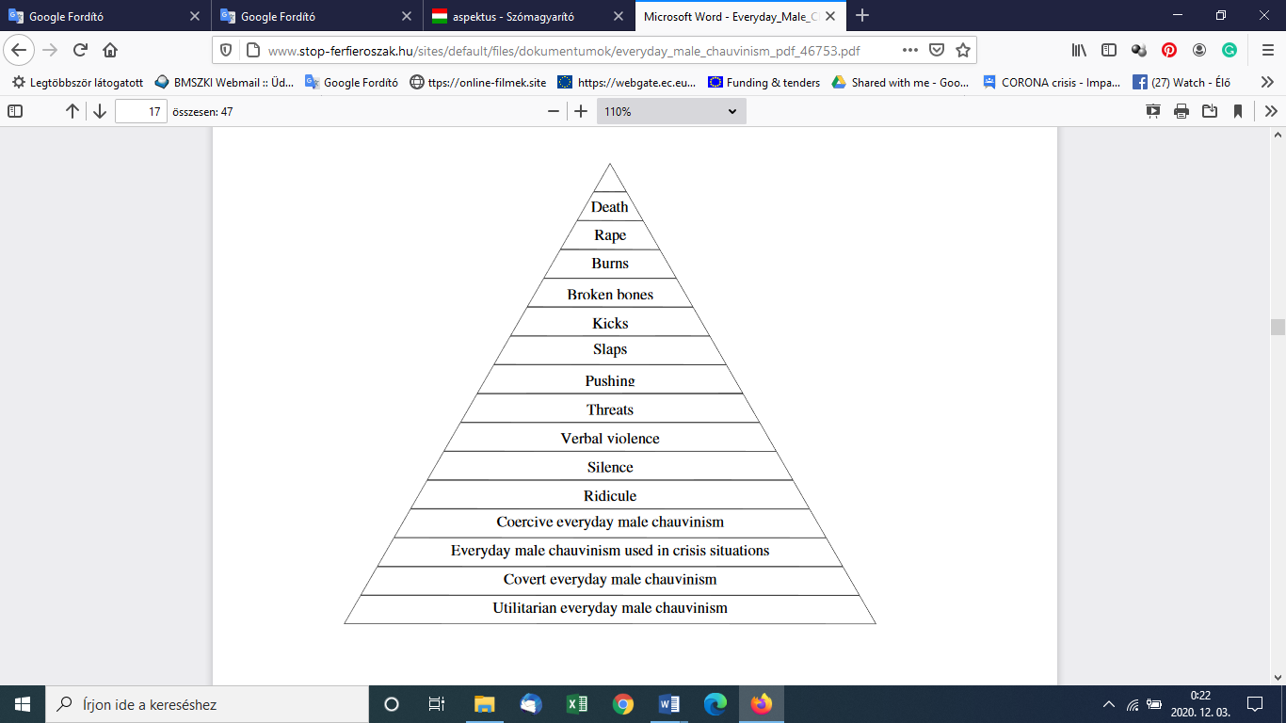

Slide 11
coercive everyday male chauvinism
Behavioural strategies in which the man uses force directly but not physicaly.
Usage of moral, psychic or economic force, or a force that comes from his personality, to break the woman’s will, limit her freedom, monopolise her thoughts, time, life-space and to narrow down her freedom of decision.
Everyday male chauvinism used in crisis situations
Behaviours that are used by man in cases when a crisis comes and the stable inequality of power in the relationship starts moving toward a greater equality.

Slide 12
Covert everyday male chauvinism
Hidden technics used by man to take advantages of his partner’s love and trust towards him to make her do things that reduces her opportunities and making steps against her own will to the direction dictated by the man.
Utilitarian Everyday male chauvinism
Technics that are used to to withdraw from common activities and duties while they are completed only by his partner.

