Slide 1
harm reduction
and sexual health
Roland Gyékiss - Aternative Foundation [ALTALAP]

Slide 2
harm reduction encompasses interventions, programmes and policies that seek to reduce the health, social and economic harms of drug use to individuals, communities and societies.
HARM REDUCTION
upstream to reduce the risk of negative consequences (primary prevention)
Definition of EMCDDA
downstream to reduce negative consequences (secondary or tertiary prevention)
the field of action covers the entire intervention continuum

Slide 3
•the experience of the ongoing state of physical, psychological, and sociocultural well being related to sexuality.
•it is evidenced in the free and responsible expressions of sexual capabilities that foster harmonious personal and social wellness, enriching individual and social life.
SEXUAL HEALTH
Definition of WHO*
•it is not merely the absence of dysfunction, disease and/or infirmity.
•for sexual health to be attained and maintained it is necessary that the sexual rights of all people be recognized and upheld.
*this is a working definition and has not been officially adopted by WHO

Slide 4
STBBIs
{sexually transmitted and blood-borne infections}
STBBIs are not distributed equally among populations
over half of the people newly infected with HIV are members of key populations or their sexual partners: men who have sex with men, sex workers, people who inject drugs, transgender people, migrants and people in prisons
almost one quarter of the people newly infected with hepatitis C virus globally inject drugs, and more than half the people who inject drugs have chronic hepatitis C virus infection
STI incidence among adolescents is the highest compared with other age groups
Progress report on HIV, viral hepatitis and sexually transmitted infections, WHO 2019

Slide 5
3 CLEAR MESSAGE
1
2
3
TO PREVENT
TO DETECT
TO TREAT
Targeted community measures
Easier access to screening tests for vulnerable populations
To influence the service and professional practice organizations
Raise awareness of co-infection HIV-STIs among health professionals
Make condoms more accessible
Activities and services adapted to vulnerable populations
Make post-exposure prophylactic treatments available in a professional and non- professional setting
Prevent transmission

Slide 6
3 INTERVENTION APPROACHES TO REDUCE STBBIs
1
2
3
Provide services to at-risk populations
Organize activities where at-risk populations live
Create environments that are conducive to prevention
But to establish these approaches we need government guidance and support

Slide 7
MEANWHILE IN HUNGARY
collective punishment of vulnerable groups by the state {the punishment of homelessness, migrants...}
legislation restricting the rights of LGBTQ people
conservative prohibition based drug policy
Hungary does not have and HIV strategy since 2010
Harm reduction is negatively considered by the government
closing of needle exchange programs
no epidemiological prevalence survey done among the risk group
Hungarian legislation and regulations on HIV testing

Slide 8
WE ARE
OUR VISION IS A WORLD WHERE NOBODY CONTRACTS HIV EVER AGAIN

Slide 9
to support the most marginalized, stigmatized, vulnerable social groups (PWUD, sex workers, MSM) who are exposed to high levels of health risks and infections, especially HIV/STD by helping these groups to have better access to social and health care services.
THE MISSION
to reduce risk behavior and raise awareness about sexually transmitted diseases in high risk community by promoting testing and earlier diagnosis. We provide HIV/STD rapid tests, counseling, harm reduction materials The objective of the low-threshold service is to reach out and establish contact with people with high risk behaviour (PWUDIV, sex workers, MSM),
THE AIM
increase the number people living with HIV who are aware of their HIV status early on, provide them health and social services and prevent forward transmission
THE GOAL

Slide 10
SERVICES
CHECKPOINT BP
community based HIV/STD test and counseling
GIRLS of ILLÉS St.
outreach program for street sex workers
SEX&DRUGS&HARM REDUCTION
safe sex and safer drug use kits
ONLINE COUNSELING
new challenges

Slide 11
THE CREW
professionals
activists
volunteers
peers
PLHIV
MSM

Slide 12
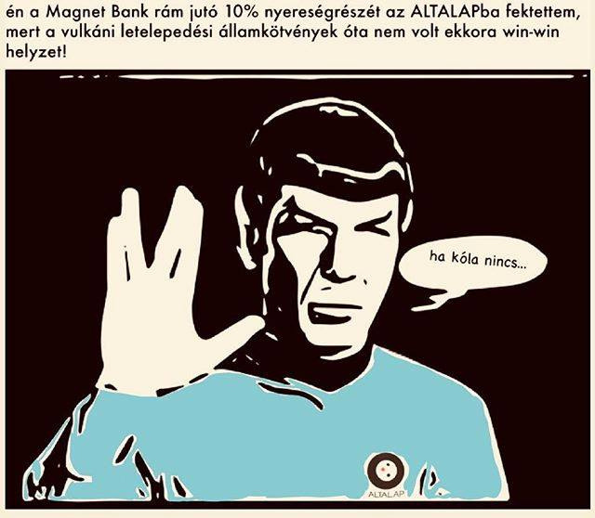
altalap.hu

