Slide 1
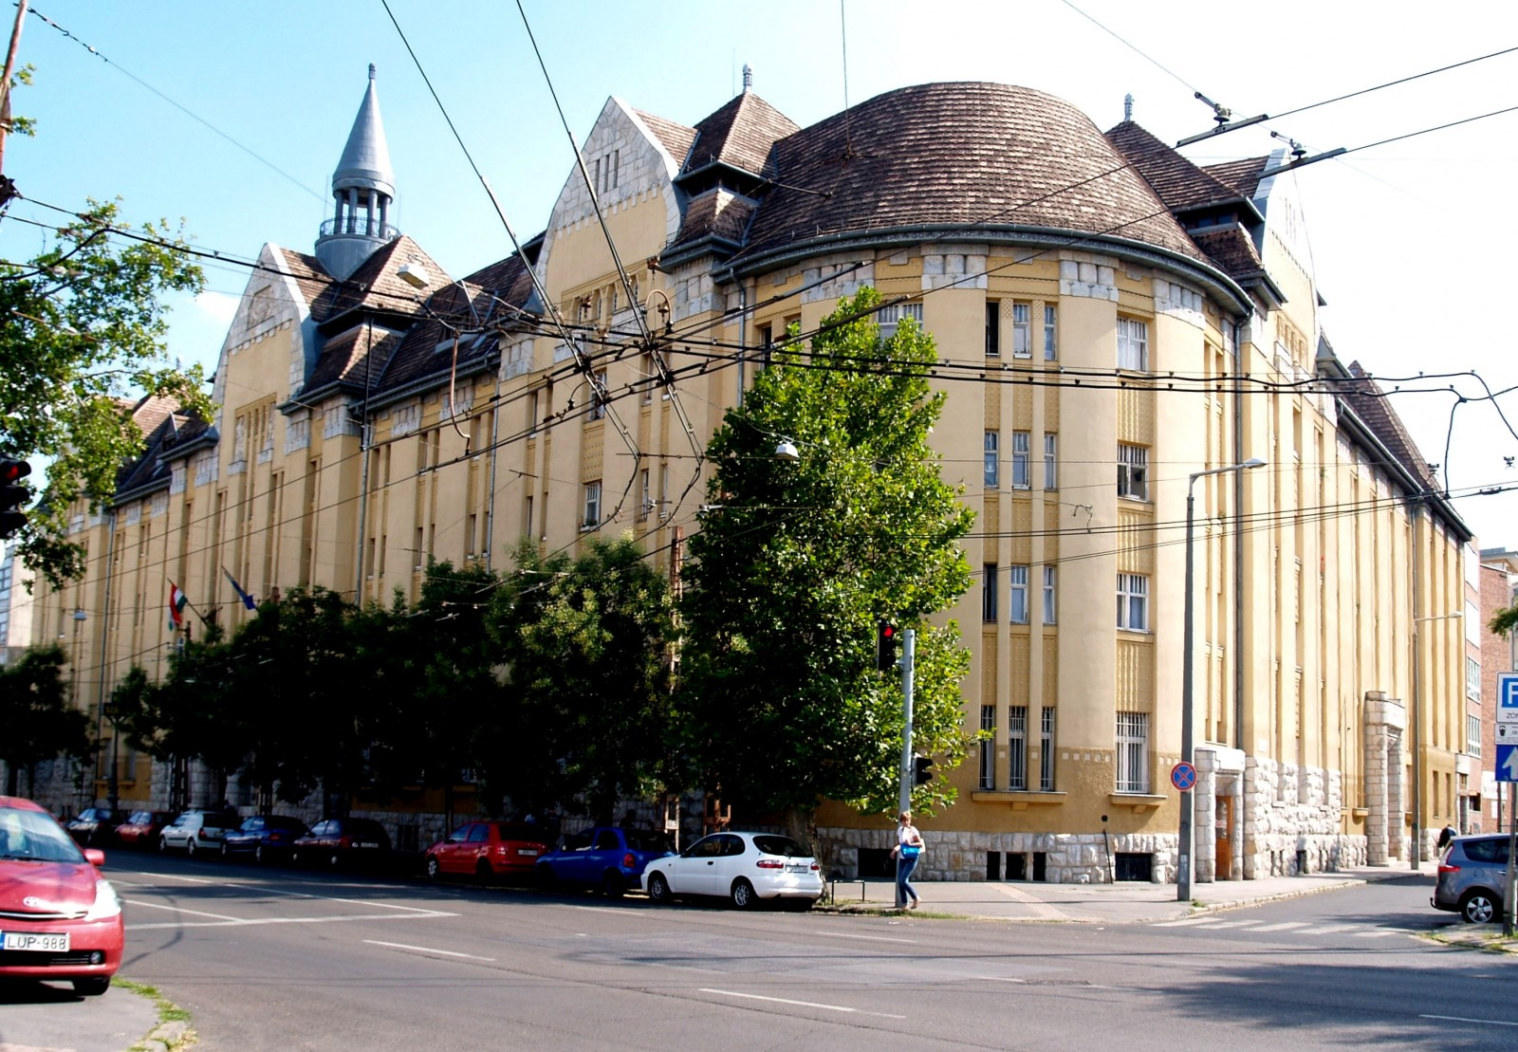
Intimacy and sexuality experiences from clients and support workers at homeless service provision
Tamás Bakosi
(professional leader, BMSZKI Dózsa Temporary Hostel, bakosi.tamas@bmszki.hu)

Slide 2
Perceptions
Taboos and prejudices on the side of support workers
Taboos and fears on the side of service users
Dilemmas about competency boundaries
Jams in support progress
Lack of self-awareness and language regarding intimate issues
Relations without trustfulness
Secrets in the supporting process

Slide 3
Small scale research (T. Bakosi 2016/18)
Focus groups with support workers
Themes:
Accommodation services with placements for couples
Night shelters, day centers
Intimate rooms and other good practices
Interviews with service users (All kind of service provision - 8 interviews – there were men and women among the interviewees)
An article about the findings in Hungarian: https://dea.lib.unideb.hu/dea/bitstream/handle/2437/295591/Bakosi_Hajlektalansag_es_szexualitas.pdf?sequence=1

Slide 4
Experience and feedbacks from staff (Focus groups)
In most cases this issue is not part of the support process
It should be discussed with service users when it brings other difficulties with it
It is hard to communicate directly about it (sometimes the clients’ words makes the support workers uncomfortable)
There would be a need for informative counselling or groups for young service users
Many women have got lack of knowledge about STD-s, contraception and pregnancy
Some service users have risky sexual behaviour, survival sex or sex work

Slide 5
Experience and feedbacks from staff (Focus groups)
Units for couples:
Opportunity for intimacy
The first experience for many people what is like living together
Shelters and day centers:
Dilemmas about dignity:
Rooms for more than one couples
Day centers: There is no place for intimate actions. Service users try to be together at the shower room but that is against the rules and may cause conflicts. The consequence is a ban from the service.

Slide 6
Experience and feedbacks from staff (Focus groups)
Temporary hostels without units for couples:
Newly forming couples facing difficulties to have access for units for couples
Service users often pays huge amount for a room to be together at hotels for some of hours
In some services the guestroom can be offered for couples to be together

Slide 7
Quotes from service users
“It would be nice, although at my age I would only like to be held, hugged, but who woud do so here... I don't know how others do anything, but I have not been thinking about it, I need something else.” (62 years old woman who were sleeping in a night shelter)
“Finding a job and getting back to my old life as soon as possible, then I will be in a situation to think about something like this, but now I cannot... I'm not saying it's not important, but not that important.” (42 years old man , using the services of a day center)
“I can do everything on the q.t. There are little nooks here and sometimes it's dark... I'm not saying that a permanent partner would be nice, but it's hard to find one here, and I work a lot.” And he added a bit later: ”You can always find a woman for this…” (24 old man, living in a temporary hostel)
“…we're here for each other, they don't really know we're together, but those who sleeps here don't need to, it's none of their business... we've applied for a hostel for couples, luckily there's a possibility for that…” (38 years old women, living in a temporary hostel)
“If we had a problem in this area or something, I might ask her. After all, she already knows almost everything about us.” (50 years old man living in a unit for couples)

Slide 8
Issues that can be hard to talk about
LMBTQI
Emotional issues
Prostitution
Sex work
crime
STD infections
Relationship problems
Substance use

Slide 9
What we have done to enhance confidence level of support workers
Who we are : 1 social worker, 1 psychologist, 1 qualified nurse
Awareness- raising workshops on conferences and professional days)
Awareness-raising discussions within our team
Skill-development workshop within our team
Awareness raising posters and film clubs for clients
Planning a training about intimacy and sexuality for professionals working with homeless people

Slide 10
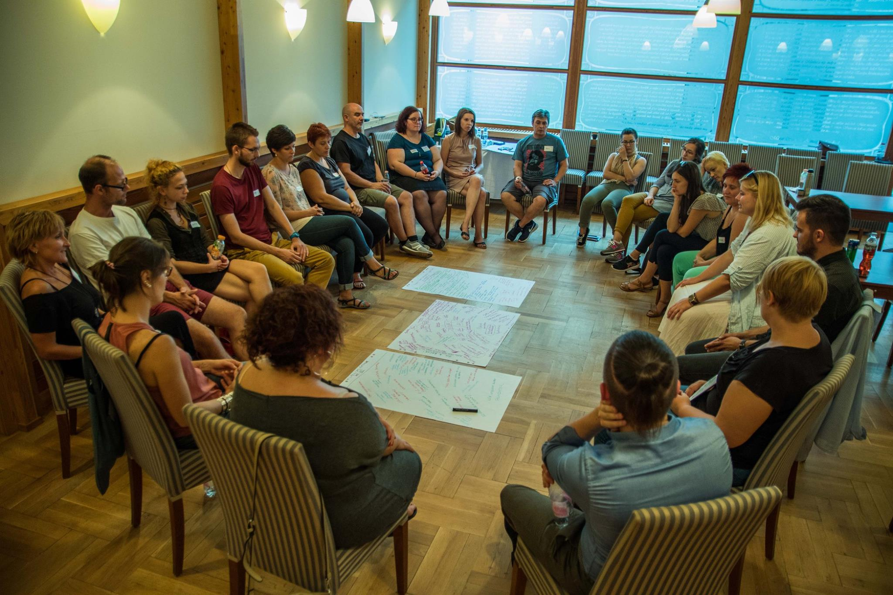
Awareness-raising workshops
1,5 - 2 hours interactive occasions for staff
(receptionists, social workers, administrators)
- Sociometric exercises
- Proxemic exercises
- YES/No exercise ( prejudice and considering)
- Language and definition cards
Quotes from clients
- Handouts about LGBTQ+
- Access to STD tests and treatments
- Condoms and tests for social worker’s team

Slide 11
Because we do not believe in taboos…

