Slide 1
Women and Housing
Housing solutions in response to the specific needs of women

Slide 2
Summary of the research
Research question:
Why do women experience more difficulties in terms of access to housing in Hungary?
What are the specific housing-related needs of women in Hungary?
To what extent does the Hungarian social service system respond to those needs / how could this be improved?
What long-term housing solutions are available, and how could access to these be improved?
Who are the actors in the field of housing solutions for women?
Methodology
international literature and good examples on housing concepts targeting the needs of women
20 interviews:
Hungarian and foreign institutions providing housing solutions to women
Hungarian and foreign NGO’s providing housing solutions to women
Municipalities
Affected women
Main arguments
Due to gender-based economic inequality, women are systematically in a worse housing situation
Unequal household-related and childcare tasks
Worse position on the formal labour market
The housing difficulties of women are inherently linked to the phenomenon of violence against women

Slide 3
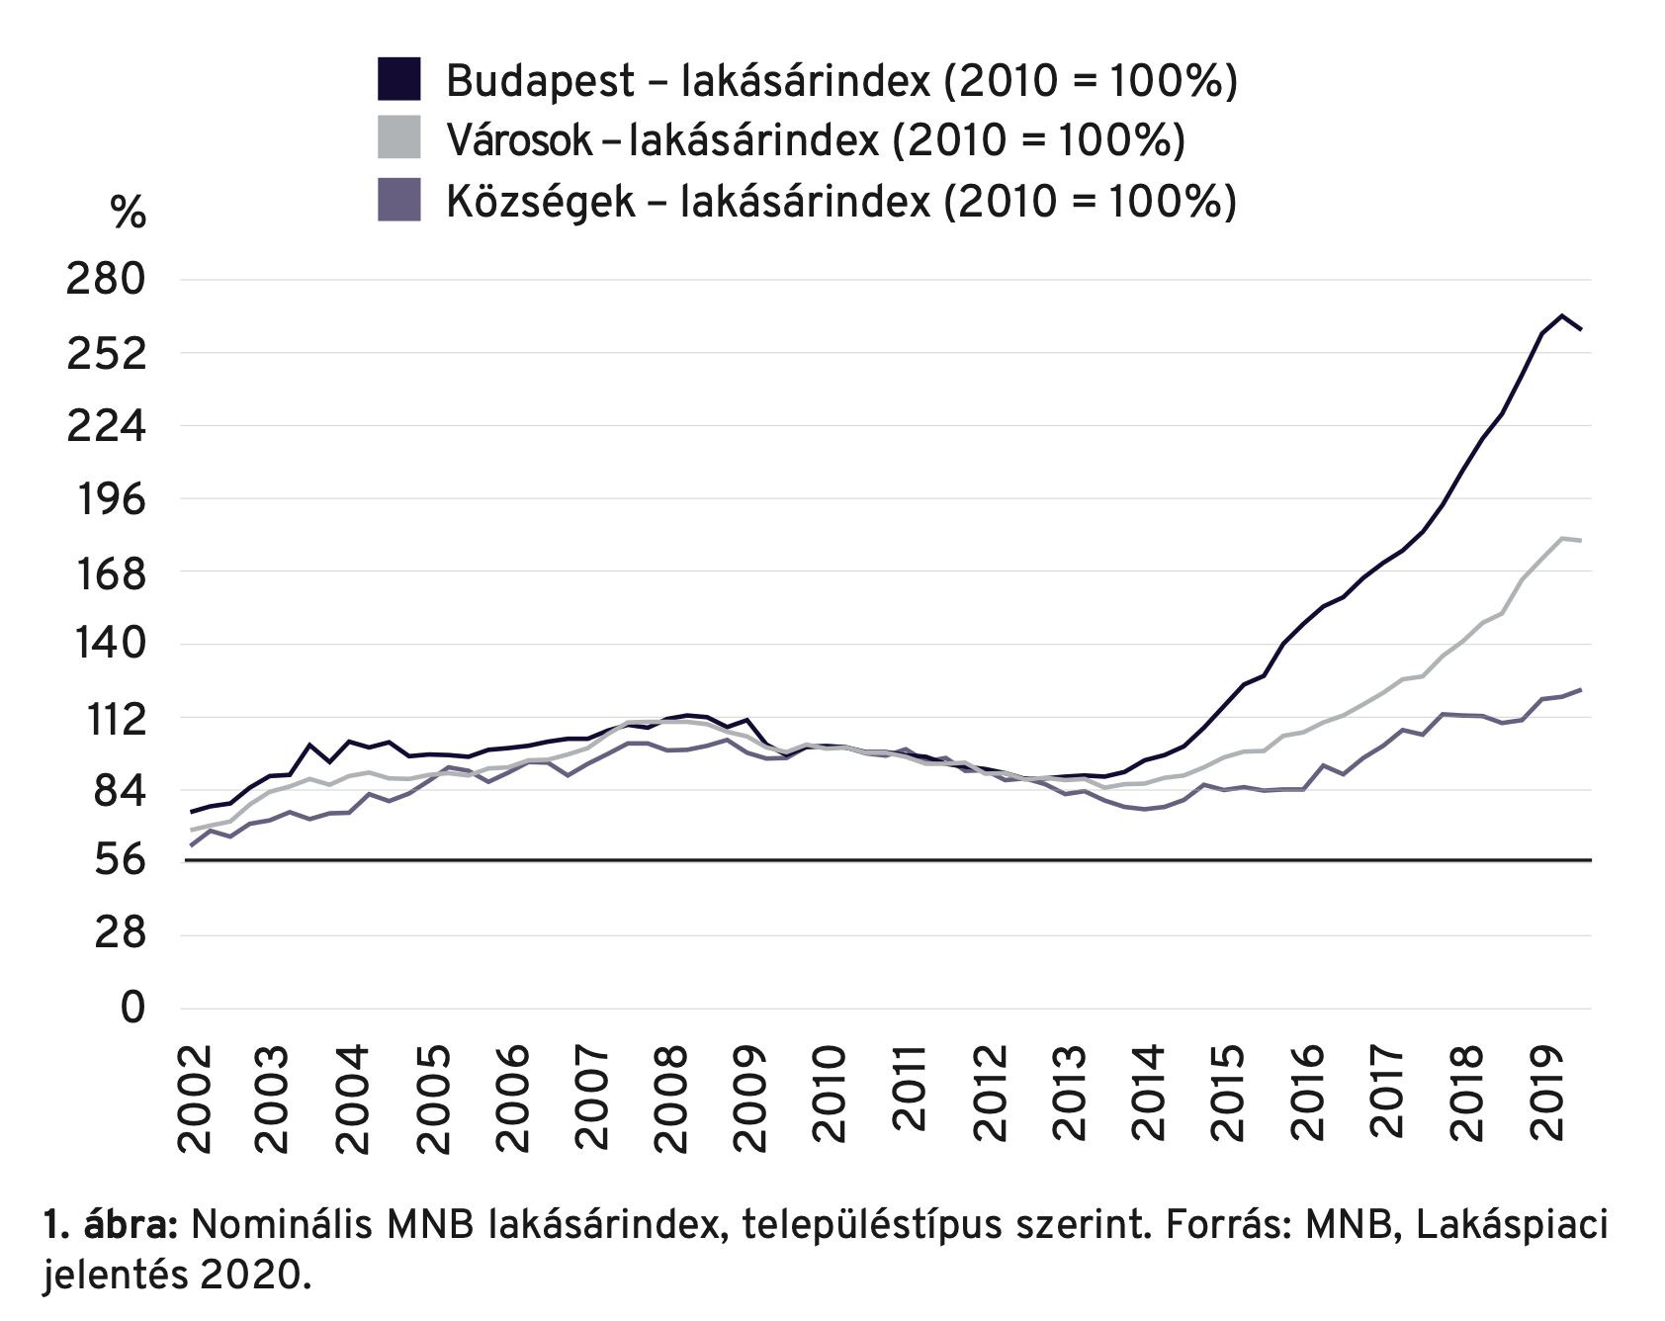
Housing inequalities
Homeownership
After 2008: household debt crisis - over-indebtedness affects women disproportionately
Since 2015: extreme house-price and rental price increase, housing inequalities increase
Socially selective government support to home-buying » more inequality
Graph: Nominal Central Bank house price index, by settlement categories (Budapest - cities - smaller settlements)

Slide 4
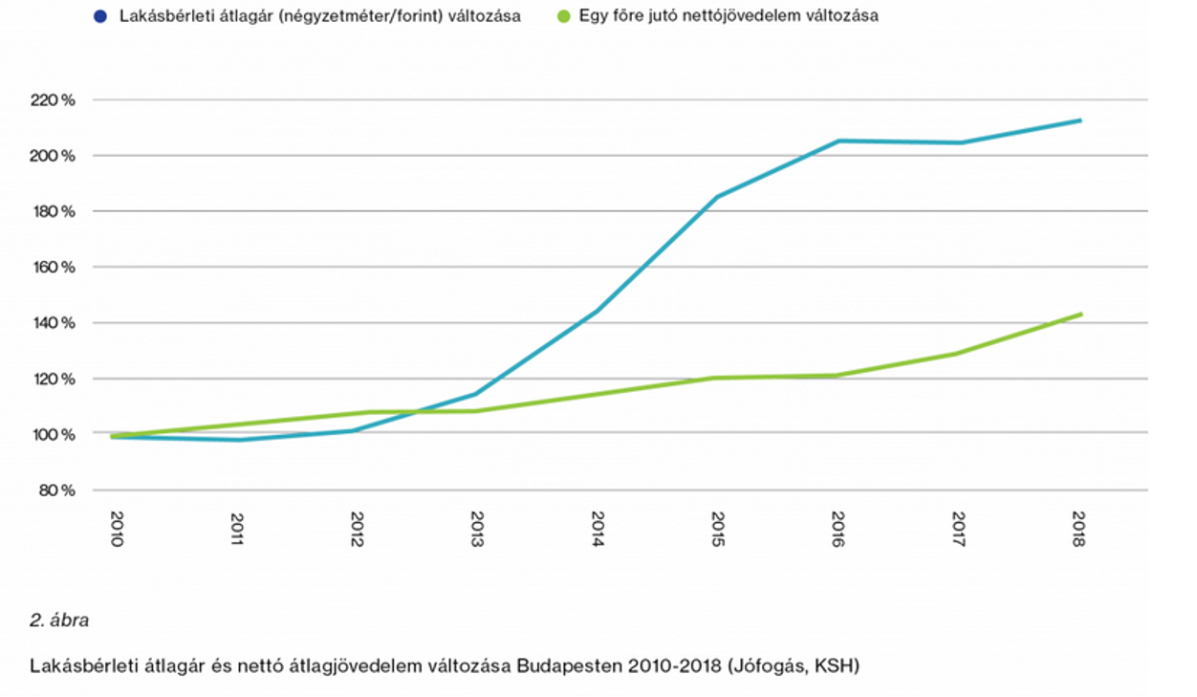
Housing inequalities
Private rental sector
Extreme rise of urban rental prices, big spatial inequalities
Opening gap between rental prices and income
Municipal rental housing sector
Constantly diminishing, too small
Fragmented system
Graph: Change in Budapest average market rental prices and average income since 2010

Slide 5
Housing inequalities
Homeownership
After 2008: household debt crisis - over-indebtedness affects women disproportionately
Since 2015: extreme house-price and rental price increase, housing inequalities increase
Socially selective government support to home-buying » more inequality
Private rental sector
Extreme rise of urban rental prices, big spatial inequalities
Opening gap between rental prices and income
Municipal rental housing sector
Constantly diminishing, too small
Fragmented system
»»»»»»»»»»»»»
Problems of access
Over-crowded apartments, non-chosen cohabitation
Spatial segregation
Getting stuck in institutions providing accommodation
Problems of affordability
Arrears, debt and late payment - enforcement on income, disconnection from utilities
Bad housing quality
High share of income goes to housing costs - especially among poor

Slide 6
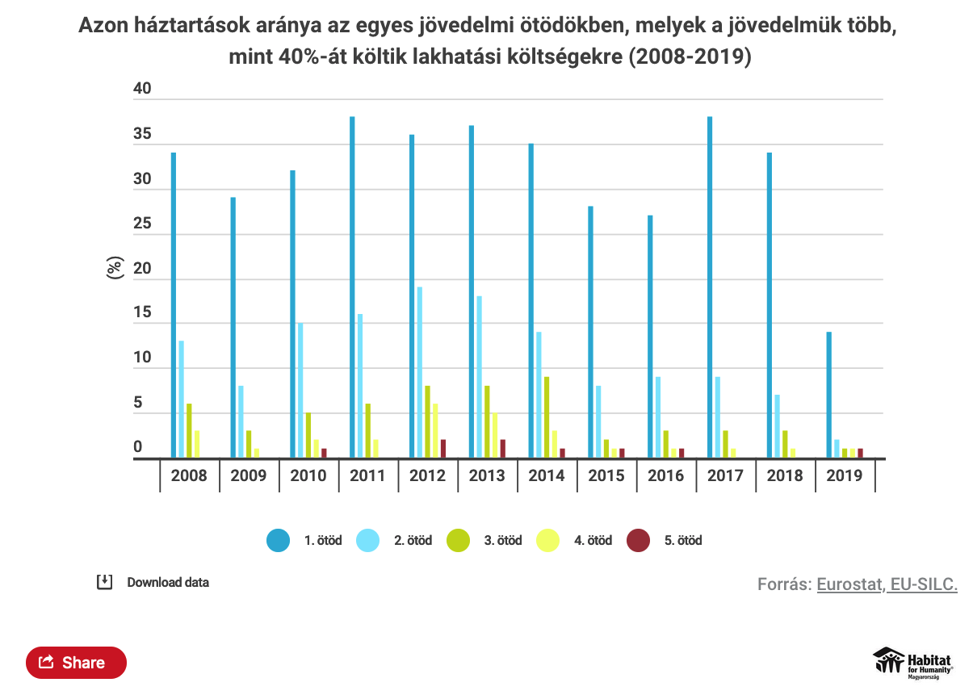
Graph: Share of households in each income quintile who spend more than 40% of their income on housing.

Slide 7
Housing services in Hungary
Most of the state housing services in Hungary offer temporary housing solutions: shelters for nights, few months, few years
There are no long-term housing solutions for women after they escape from institutions
Paternalistic social policy: the social care system defines women as mothers - elderly and single (childless) women are left out from the care system
The Hungarian social care system was founded in the 80’s-90’s (after the regime change) when the economic circumstances were better - after temporary housing people were able to solve their long-term housing on the market

Slide 8
Why is it important to specifically address the issue of housing of women?
(Watson 1991, Einhorn 1993, Zimmerman 2010, Czibere 2012, Gregor – Kováts 2019, Csányi 2019)
State socialism:
The general employment of women increased
Care and housework still framed as their work in the household
Care -related jobs
Employment of lower-class women has not increased significantly
Regime change:
The economic situation of women began to worsen drastically
disbursement of long-term but low childcare benefits
reduction of institutions linked to childcare
caring for children, elderly and disabled relatives became women's informal role
Women stuck in the household

Slide 9
Why is it important to specifically address the issue of housing of women?
Feminization of poverty
Breadwinner model - women becoming dependent on their partners (especially lower class women)
Woman stays involved in relationships because of economic reasons
Labour market segregation
The proportion of women on the labour market decreases in line with the number of children (Eurostat 2017)
Occupational segregation: within and between professions
The crisis of care (Fraser 2016)
Reconciling employment in the market with caring responsibilities (Gregor - Kováts 2018; 2020)
“Sandwich generation”
Poor institutional and financial care system
-

Slide 10
The situation of victims of violence against women in Hungary
200.000 women live in a relationship where sexual or physical violence was committed against them (FRA– 2014; Tóth 2018)
Women have to escape typically without any resources - this frequently results in a housing crisis for them
200 places in shelters for victims of violence against women
In temporary housing services (family crisis shelter, mother’s shelter) not enough places available
Institutional betrayal - lack of knowledge in the care system about the phenomenon and about the effects of violence against women

Slide 11
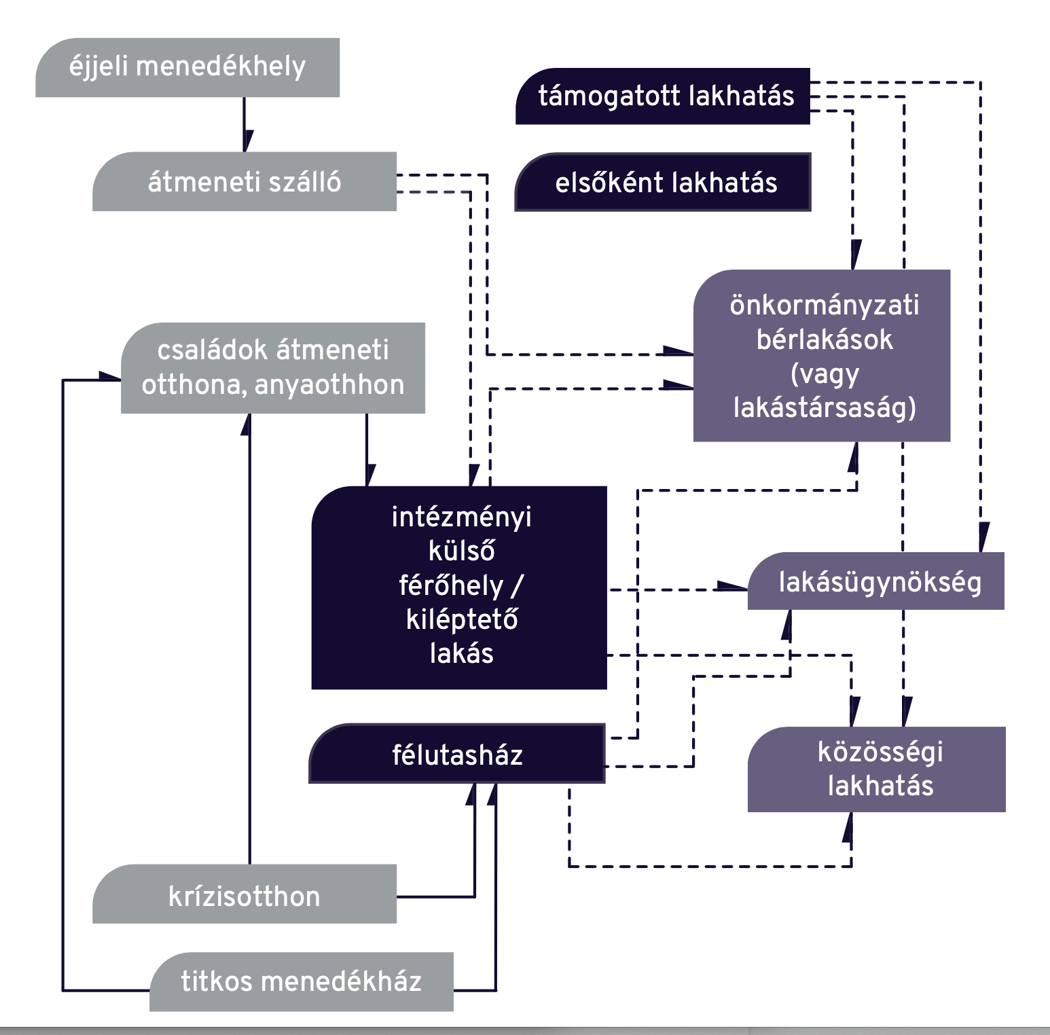
Types of housing solutions and institutions
1. Institutionalized forms of housing/ shelter
Shelters to homeless persons
Child-care related shelters (mothers’ and family shelters)
Abuse-related shelters
» should be temporary, but due to a lack of exit options, there is very often a circulation between institutions
» this is the only segment, where there are housing solutions specialized to women, but: limited time-scope of stay + only reach the poorest women (+ limited capacity)
2. Supported housing forms
Supported housing (addiction, disability, etc)
Housing First
“External units” of institutions
Halfway-houses
» independent housing supported by social work
» under-used form, need for expansion - but: resource-intensive
3. Long-term affordable housing
Municipal housing
Housing agencies (civil society org.s or religious org.s)
Community housing
» huge lack of affordable housing options - without this, the other forms are also “stuck” » urgently needs to be developed
» because of economic inequalities affecting women, there is a permanent need of affordable housing (not a temporary condition)
Importance of creating possibilities for mobility between the different forms (currently lacking).

Slide 12
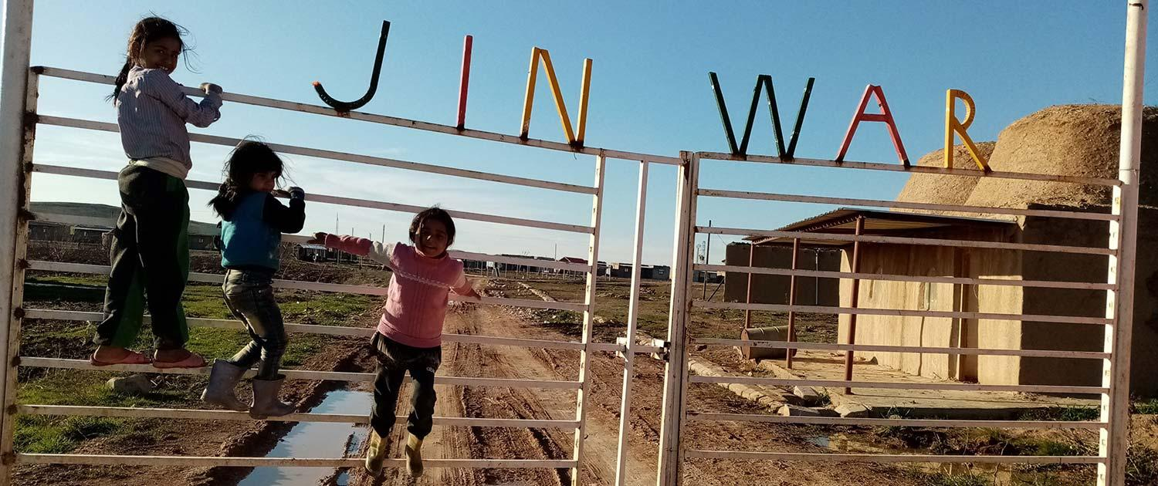
Inspiring examples
Institutional solutions
Women-only institutions
Specialized support
Safety guaranteed
Community aspects
Clear next steps and possibilities of exit
Supported housing forms
Bridging the gap between institutional solutions and independent housing
Taking the time-pressure away
Very good complex solutions
Long-term affordable housing
Affordability as a bottom line
Housing providers can implement specialized channels for women target groups
Community housing solutions
Mobility between different forms

Slide 13
Priority target groups
Single mothers
The conflict between wage work and care work
Maintaining the household alone
Low state benefits
Victims of violence against women
Escape - housing crisis
Needs:
Safety - protection from the offender
Trauma processing - trauma caused by violence
Debt management - frequently they are the officially responsible for the debt in the common household
Financial support, rent level
Labour market support
Childcare support - to be able to be present on the labour market besides the care work

Slide 14
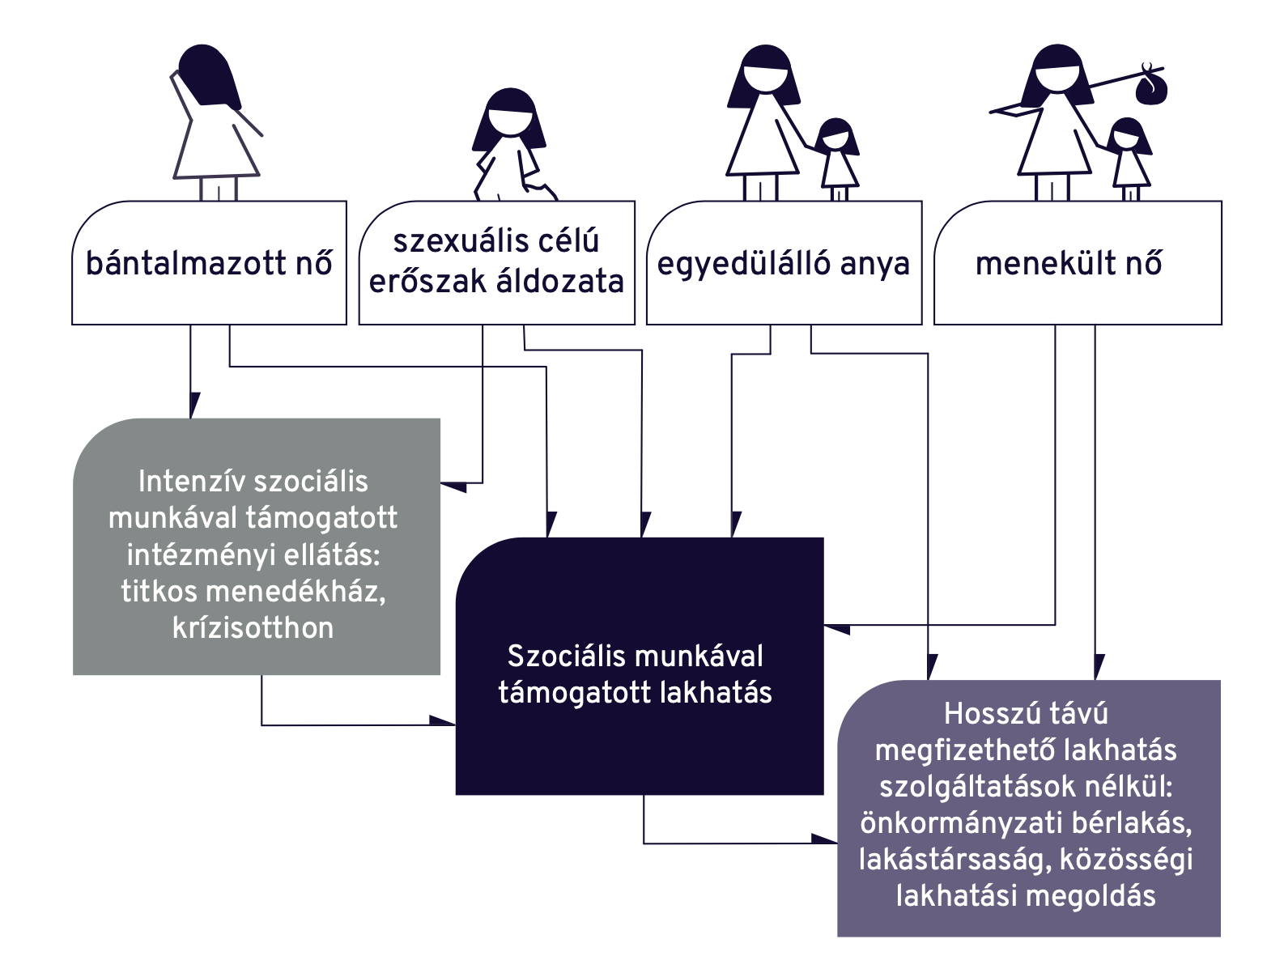
Housing services that addresses the needs of women
Victims of violence: victims of relationship violence, victims of human trafficking, victims of sex trafficking
Institutional care supported by intensive social work
Housing supported by social work
Long-term affordable housing
Women in crisis situation: single mothers, refugee women
Housing supported by social work
Long-term affordable housing
Women in economic crisis:
Long-term affordable housing

Slide 15
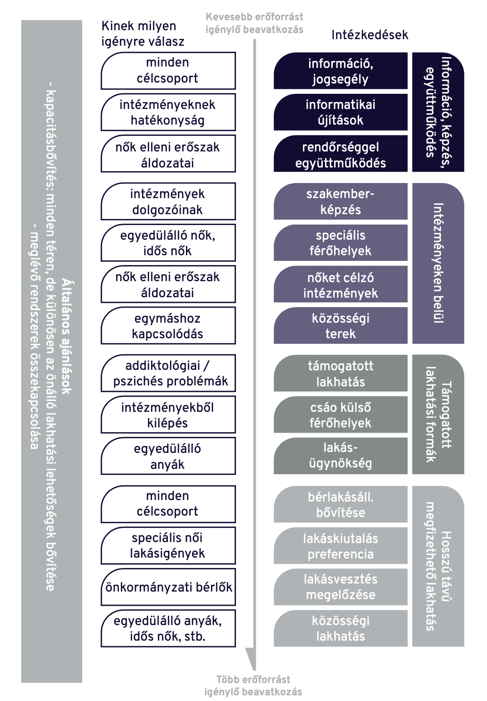
Possible forms of intervention
Municipalities - actors of social housing - but limited resources
Covid-19 pandemic: more visibility and political will to intervene in the housing situation of women - aiming to give tools and inspiration
Proposing a spectrum of possible municipal interventions in 4 topics:
Information, training, cooperation
Interventions in institutions
Supported housing forms
Long-term affordable housing
Social service providers / institutions
Training for staff in the areas of violence against women
Creating women-only institutions
Places for childless or elderly women
Reinforcing community aspects
Working on stronger connections to housing solutions, and to organizations providing housing
Establishing stronger connections with organizations supporting women - collaboration to address housing needs

Slide 16
Summary
Baseline: gender-based economic inequality
Most extreme in the case of women living in poverty, but present across the social spectrum
Childcare » disadvantages on the labour market
Specific housing difficulties of women: not present on the level of public discourse or policy solutions
Housing problems of women and violence against women - very strong links; reinforcing each other
Housing provision and dealing with housing-related tasks and bills: a task that often falls on women
Single parents: women in 70% of cases
Household management as “women’s task”
For improvement what is needed:
cooperation between different sectors
Expanding capacities on all scales of the housing spectrum, but especially in long-term affordable housing for women

